Slide 1
The “Real” Legislative Process
By: Steve A. Gray

Slide 2
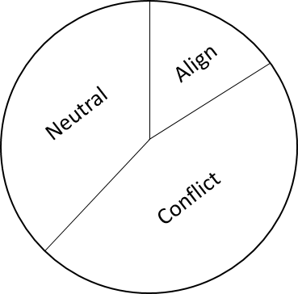
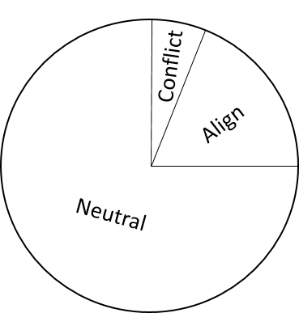
Inside Scoop Of Leadership’s Agenda
Where does your priorities stand with the leadership’s agenda
Does it conflict, align, or takes a neutral position
Tough
Situation
Idea Situation
Communicating your agenda to the leadership
Deciding to take a direct or indirect approach, or both approaches
Direct: Having substantive relationships with key leadership officials (Identifying Your Champion)
Indirect: Working through the masses (media, social/special interest groups)

Slide 3
Respecting The Chain Of Command
Leadership Executives & (Speaker, Lt. Governor, Governor)
Key committee chairman
Key members on your committee of need
Check with the majority party’s position
Check with the minority party’s position
Get key members in their respective chamber to poll their chamber
- (poll the Senate and poll the House) (poll along party lines)
Pre-Session
Commitment
Staff Included

Slide 4
The Timetable for Processing Legislation (The 9th Inning)
The Entire Process is Based Around Deadlines
Deadline for requesting and introducing General Bills/ Constitutional Amendments
Deadline for Committees to Report General Bills/Constitutional Amendment Out of OWN House or OTHER House
Deadline for introducing Revenue & Appropriation Bills
Deadline for Committees to Report Revenue & Appropriation Bills out of OWN House or OTHER House
Deadline for Floor Action in each Respective Chamber
Deadline for introducing Local & Private (revenue or non-revenue)
Deadline for Concurrence & Non-Concurrence
Deadline for Conference Report to be Filed
Deadline for Conference Report to be Adopted
Deadline for Motions to Reconsider

Slide 5
Understanding The Mississippi Legislature Website
This website is the lifeline to accurately monitoring the legislative process.
Save the URL: www.legislature.ms.gov

Slide 6
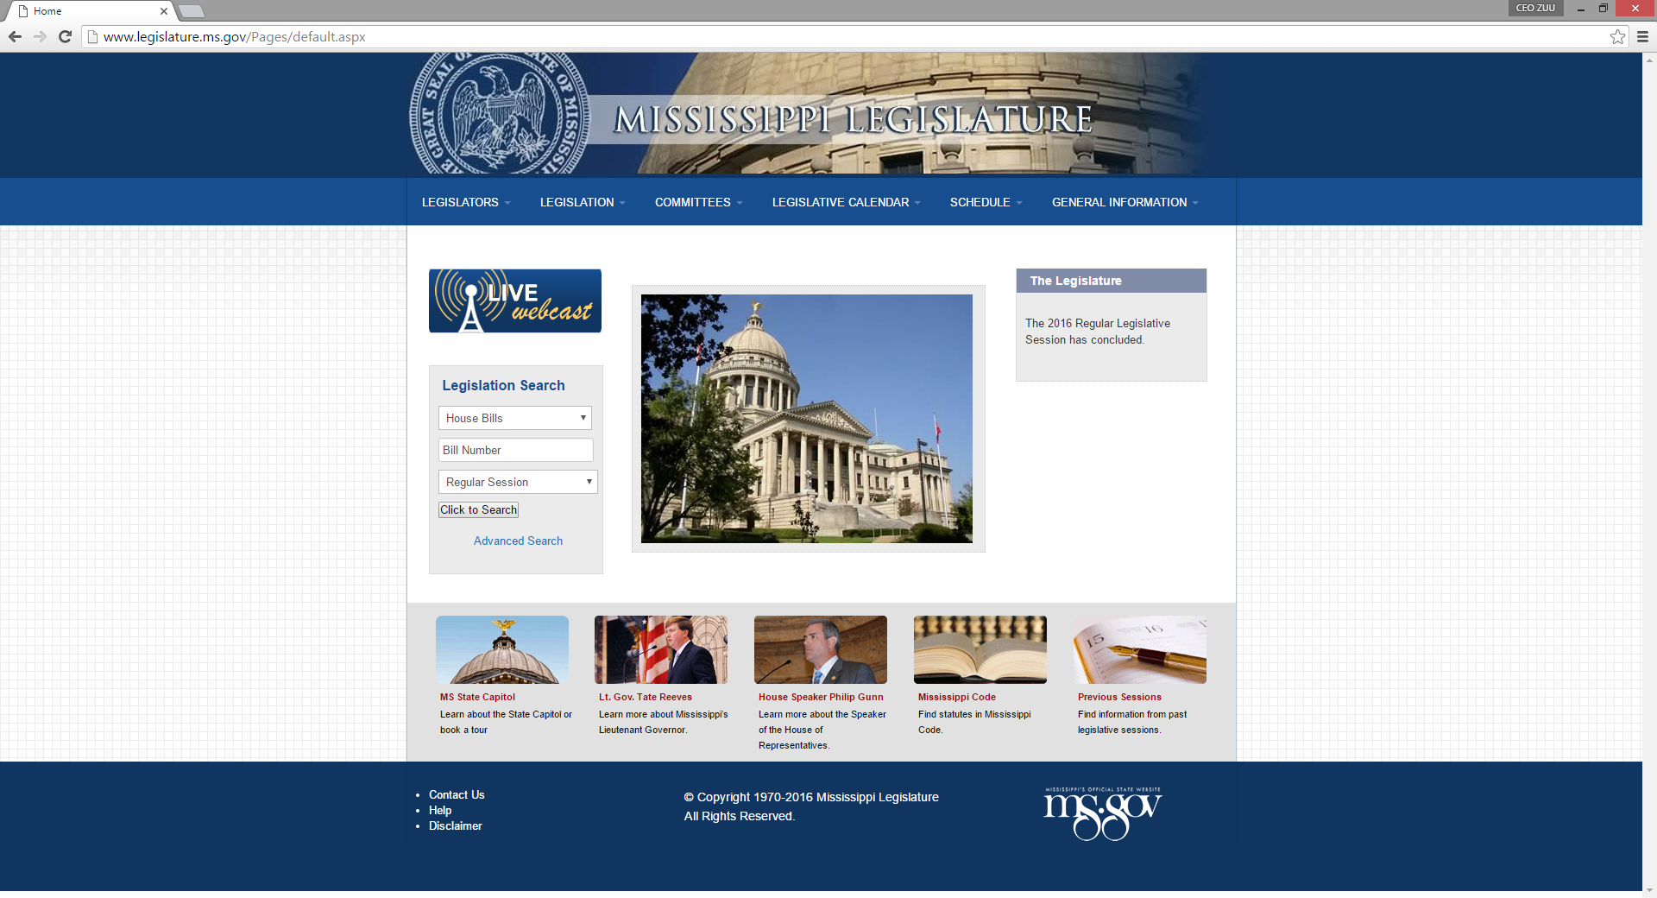

Slide 7
Room Number & Time Schedule of House & Senate Committee Meetings
Watch “Live” Broadcast of the House & Senate Floor Chamber Debates
Search House & Senate Bills
House & Senate Floor Chamber Calendar Schedule
Regular Session or Extraordinary Session
Research Bills From Previous Session

Slide 8
Monitoring the “History of Actions”

Slide 9
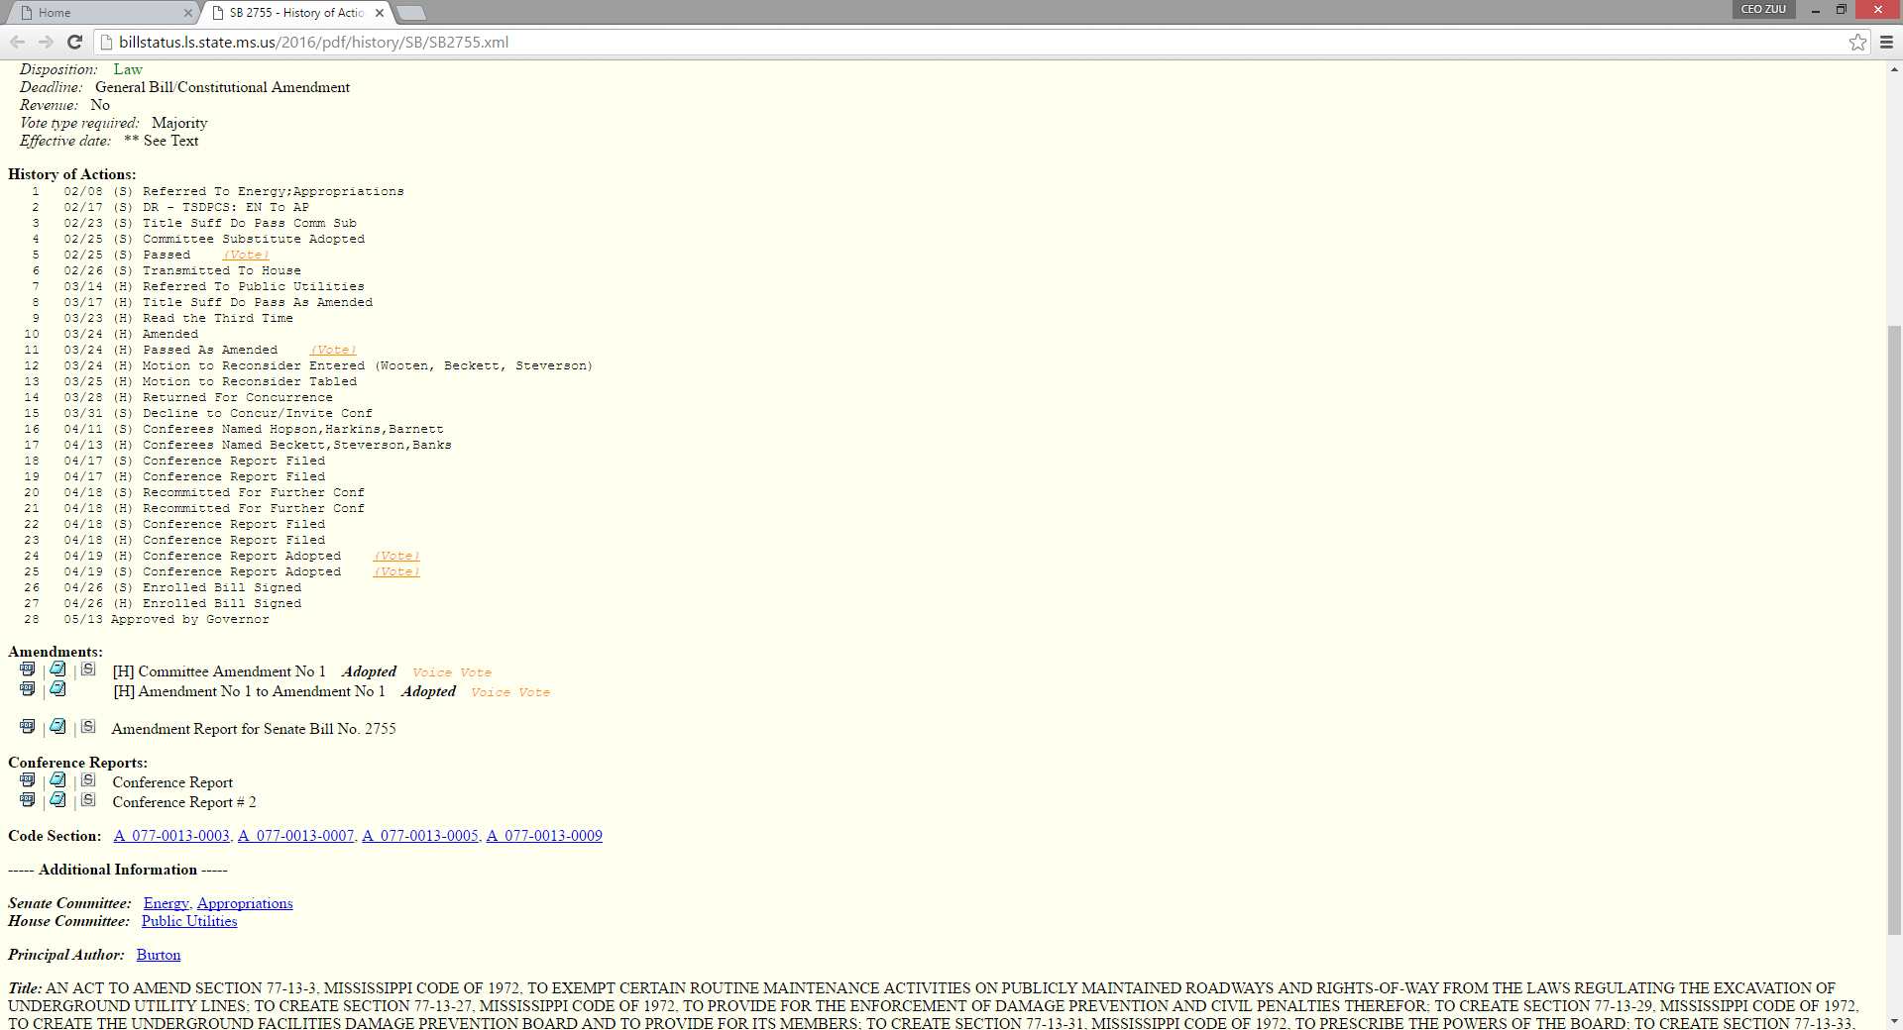
Senate Bill 2755
Excavation Law

Slide 10
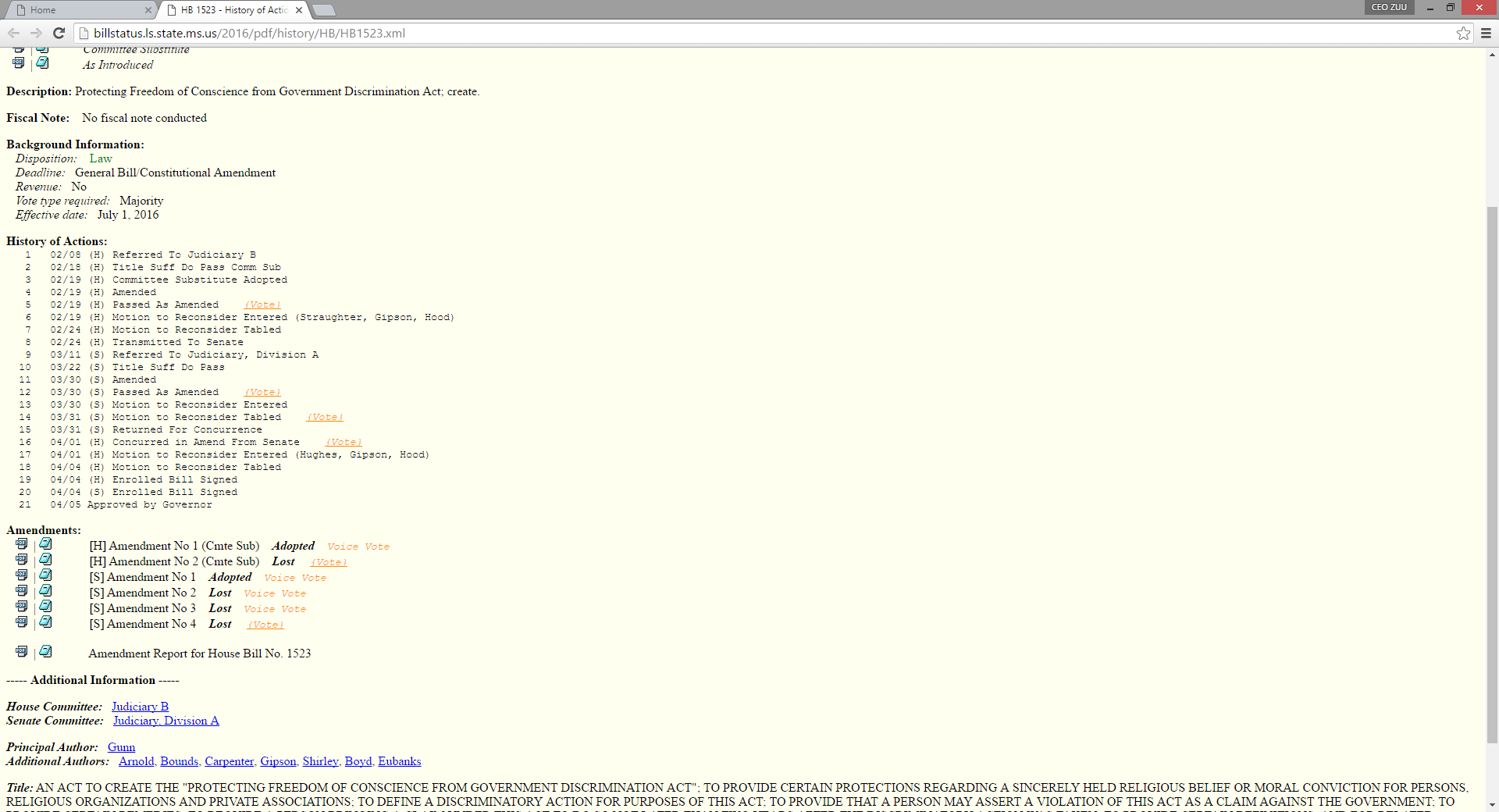
House Bill 1523
Religious Freedom

Slide 11
County Supervisors Education Certification Legislation Senate Bill 2170

Slide 12
Laying the Ground Work
Spent the summer working the Senate leadership
Developed an acceptable product
Vetted through the MAS Legislative Committee
Discussed it among the MAS membership
Identified our champions in both chambers
Got the legislation introduced

Slide 13
Working the Respective Committees
House Chamber (HB 1492)
Double Referred
County Affairs; Revenue & Expenditure General Bills
Had immediate problems with committee members, and the bill was laid on the table, in committee.
After working the House County Affairs Committee and tweaking the bill, we managed to get it passed out to the next committee
Got to the House Floor Chamber, and was recommitted back to committee and died.
Senate Chamber (SB 2170)
Single Referred
Accountability, Efficiency, & Transparency (AET)
Brokered a deal with the committee chairman and got it passed out of committee with no problems.
Got to the Senate Floor Chamber and passed the chamber 48 to 1.
Senate Bill 2170 heads to the House Chamber
Instead of single referring, the House double referred it back to County Affair & Revenue & Expenditure General Bills Committee
The House County Affairs Committee passed it out swiftly, but the Revenue & Expenditure General Bills Chairman choose not to take it up.

Slide 14
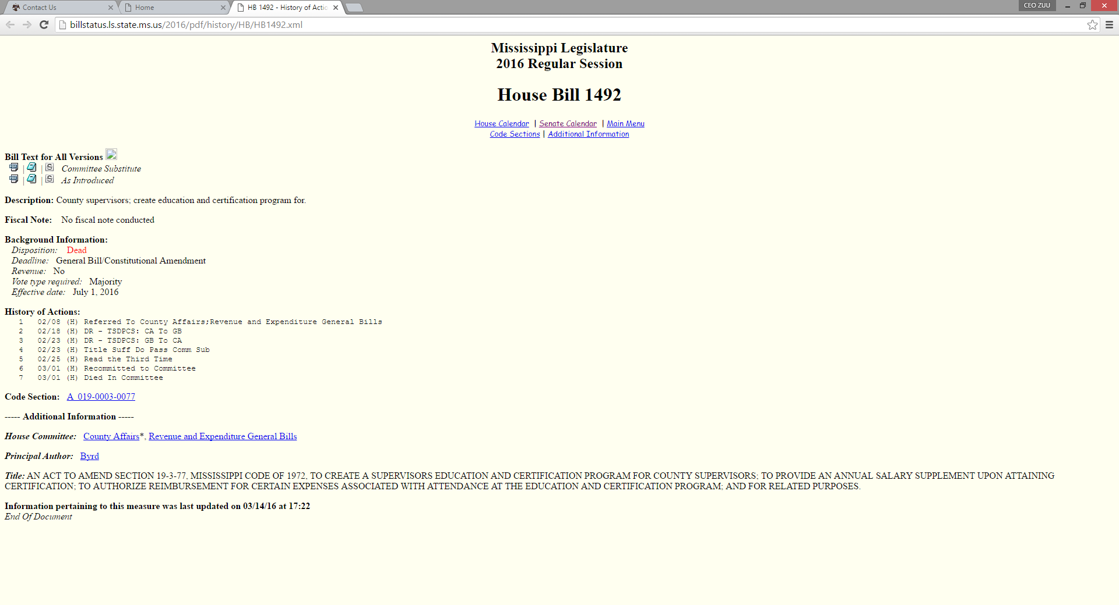

Slide 15
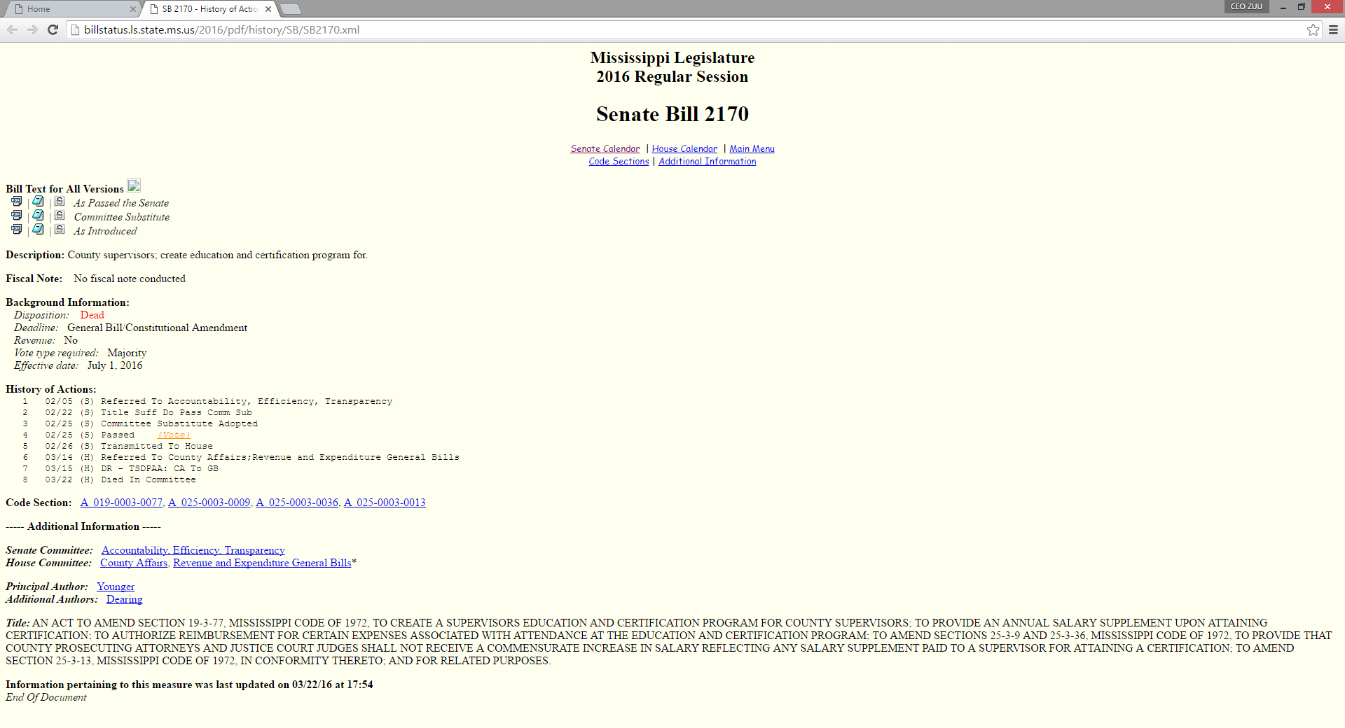

Slide 16
Conclusion
Questions?

