Slide 2
28 YR OLD MALE INMATE
Irregular heartbeat and palpitations
Surgery and pacemaker
Hospital billed $150,742.81
County paid $10,302.81

Slide 3
37 YR OLD MALE INMATE
Broken ankle at time of arrest
Surgery and pulmonary tests
Hospital billed $79,937.49
County paid $6,961.56

Slide 4
43 YR OLD MALE INMATE
Urinary tract infection
CT scans, labs and radiology
Hospital billed $9,615.62
County paid $289.13

Slide 5
BENEFITS OF PROFESSIONAL CLAIMS ADMINISTRATION
EXPERIENCED CLAIMS AUDITORS
SOPHISTICATED CLAIMS SOFTWARE
MEDICAL CLAIMS ID CARDS
PRE-AUTHORIZATION
COORDINATION OF BENEFITS & OTHER ELIGIBILITIES
EFFICIENT PROCESSING
CLAIMS MGMT FOR STOP-LOSS
PRESCRIPTION ASSISTANCE PROGRAM
MEDICAL 1099 PREPARATION
AUDIT SUPPORT
BUFFER BETWEEN ELECTED OFFICIAL AND LOCAL MEDICAL PROVIDERS

Slide 6
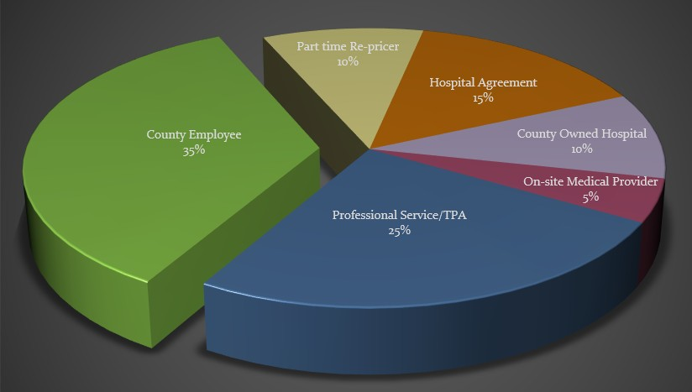

Slide 7
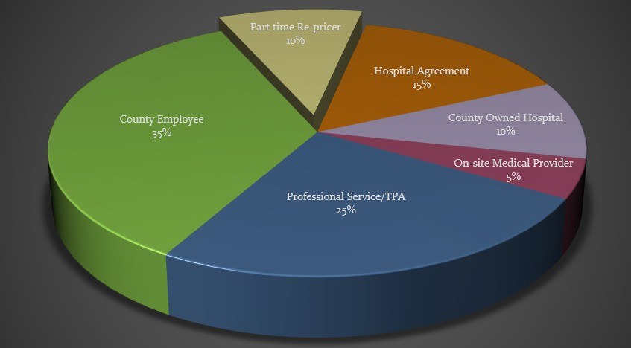

Slide 8
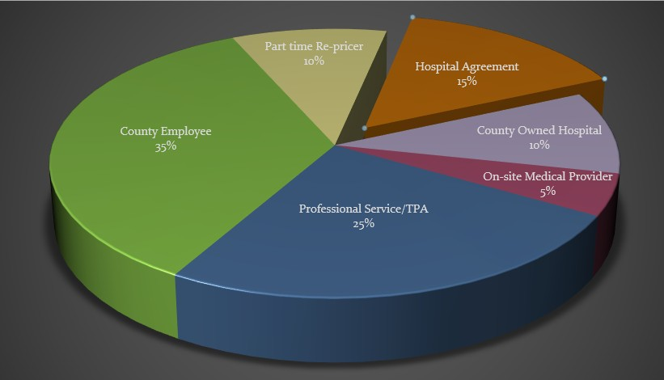

Slide 10
$5.18

Slide 12
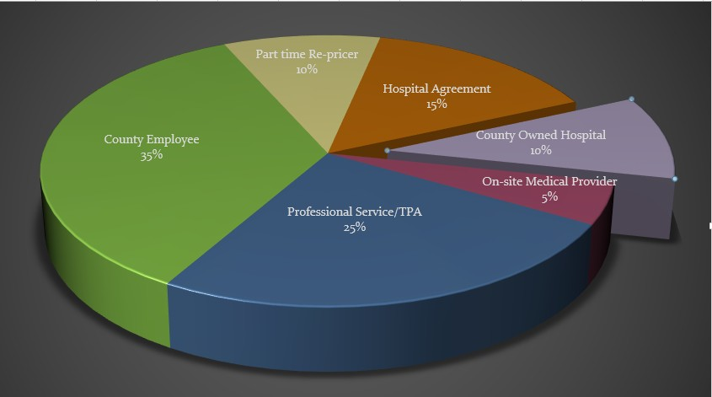

Slide 13
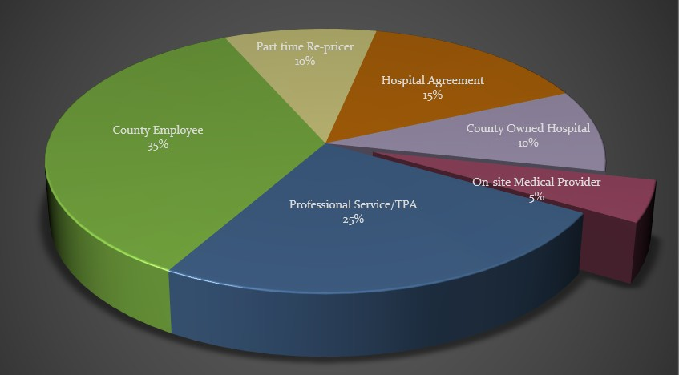

Slide 14
